Slide 1


Receiver System Using Blocks Professor Name : Mortaza Mojarad Student Name : Alireza Alivand Faculty of Electrical and Computer Engineering, Urmia University RF Communication Circuit

Slide 2

Contents : 1. Analysis 2 Simulation

Slide 3
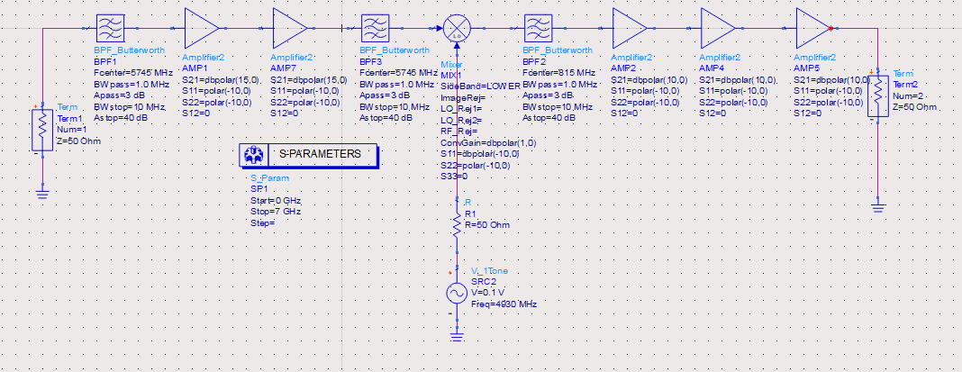


Slide 4
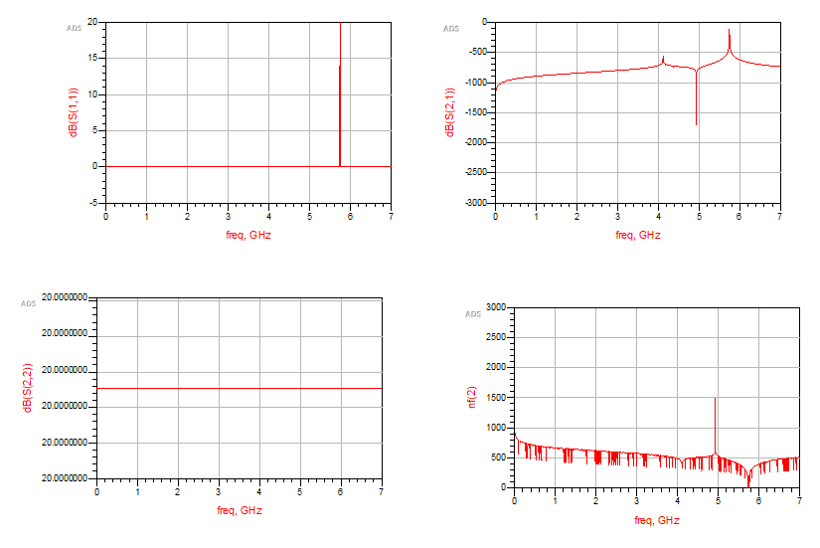


Slide 5
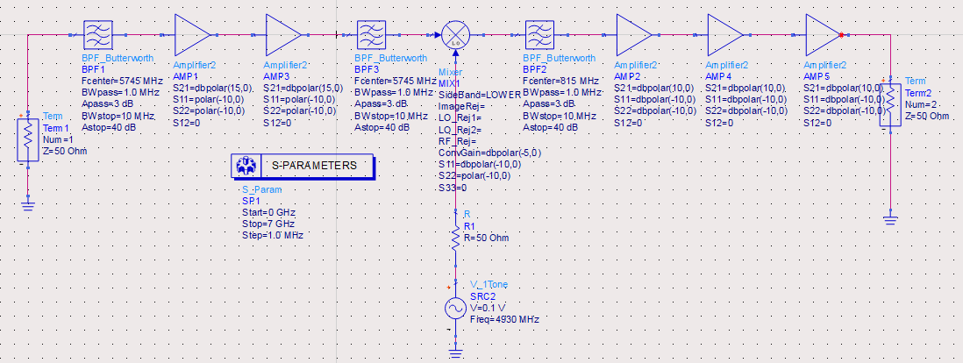


Slide 6
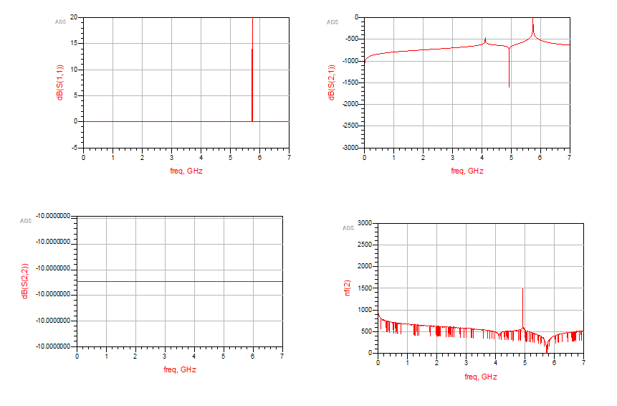


Slide 7
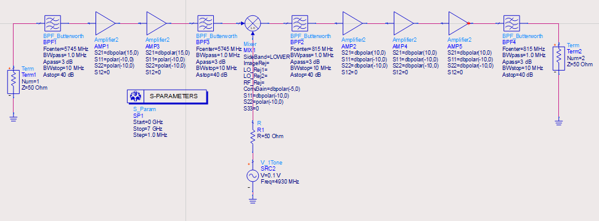


Slide 8
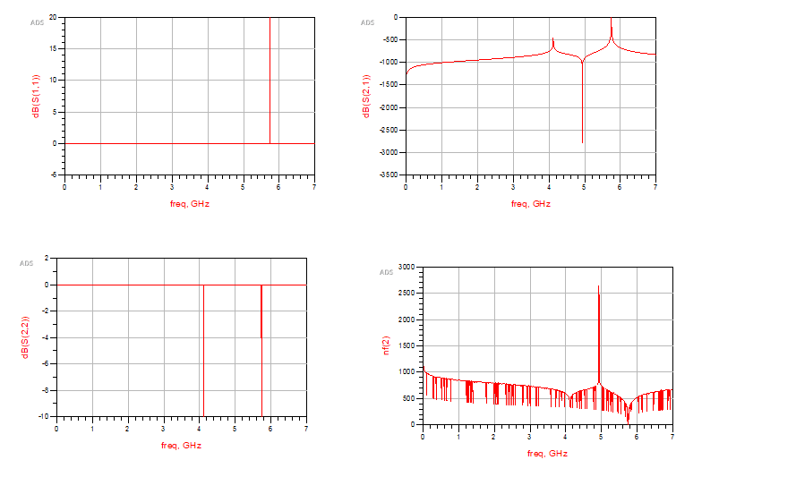


Slide 9
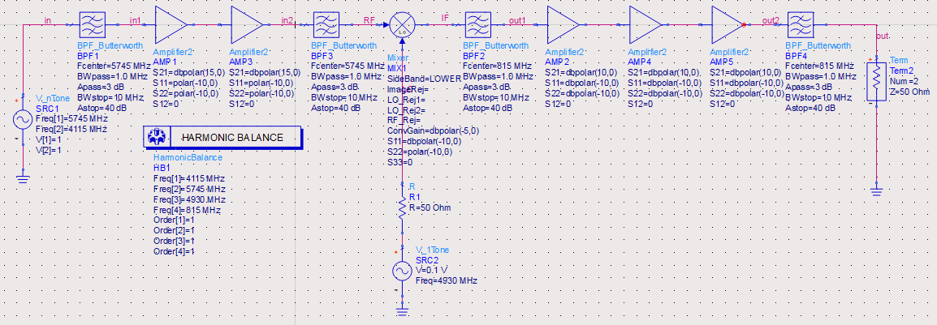


Slide 10
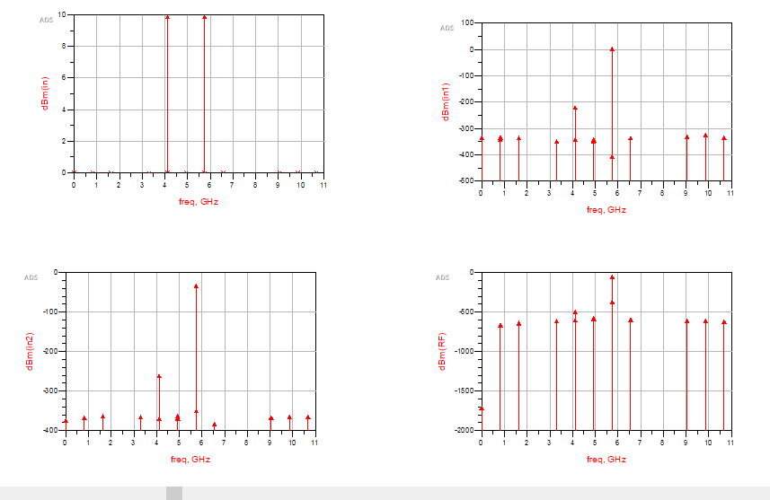


Slide 11
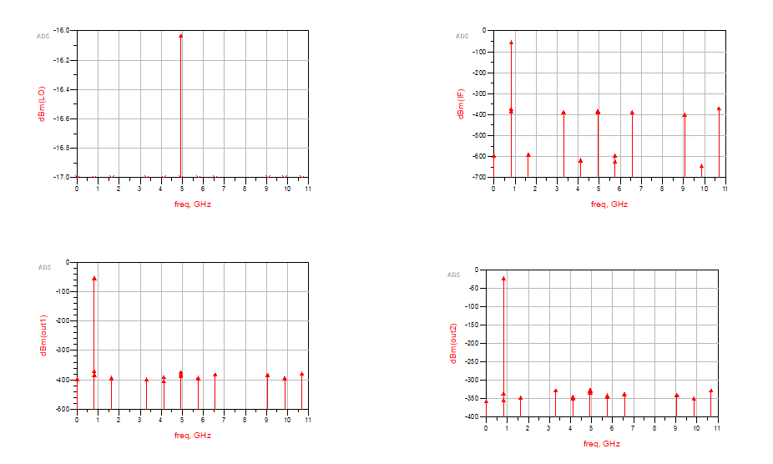

Slide 12
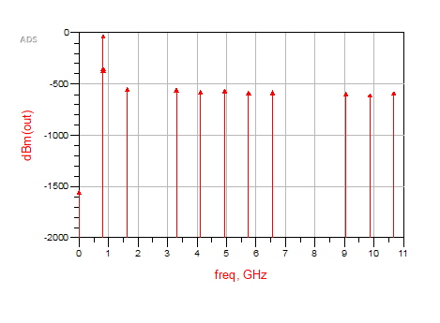

Slide 13
